Slide 1

AIRCRAFT SAFETY ANALYSIS
BY : FELISTA MWANGI

Slide 2
Business Understanding
The company plans to enter the aviation industry.
Aircraft accidents pose financial, legal, and safety risks.
Management requires data-driven insights before investing.
Historical aviation accident data is used to assess risk.

Slide 3
OBJECTIVES OF THE PROJECT
To analyze aircraft accident trends over time.
To identify aircraft types with the highest accidents rates.
.To evaluate which type of damage level has the most fatalities.
To analyze which operator have the highest accidents.
To generate insights and recommendations that management can use to guide aircraft purchasing decisions

Slide 4
DATA PREPARATION
Removed missing and invalid values.
Standardized aircraft and operator names.
Converted accident date to datetime format.
Created a year column.
Exported cleaned dataset to for Tableua

Slide 5
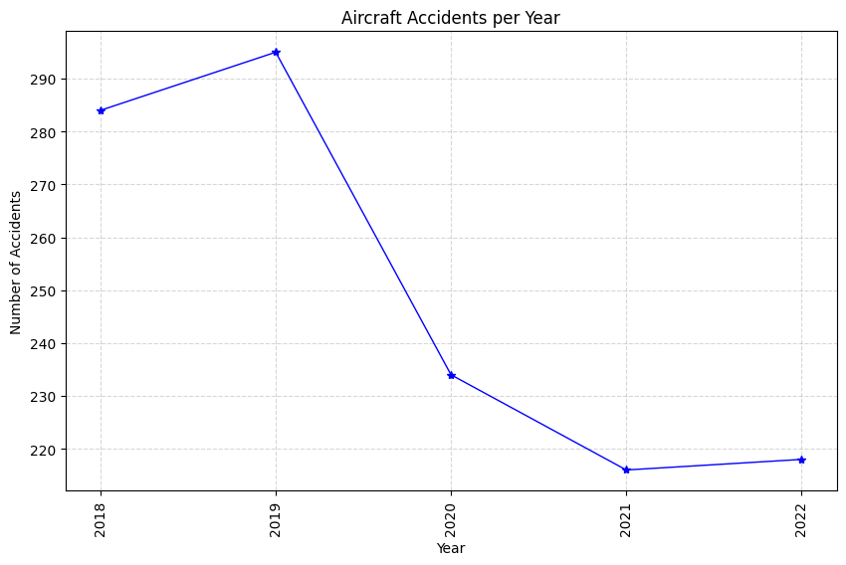
Accident Trends Over Time

Slide 6
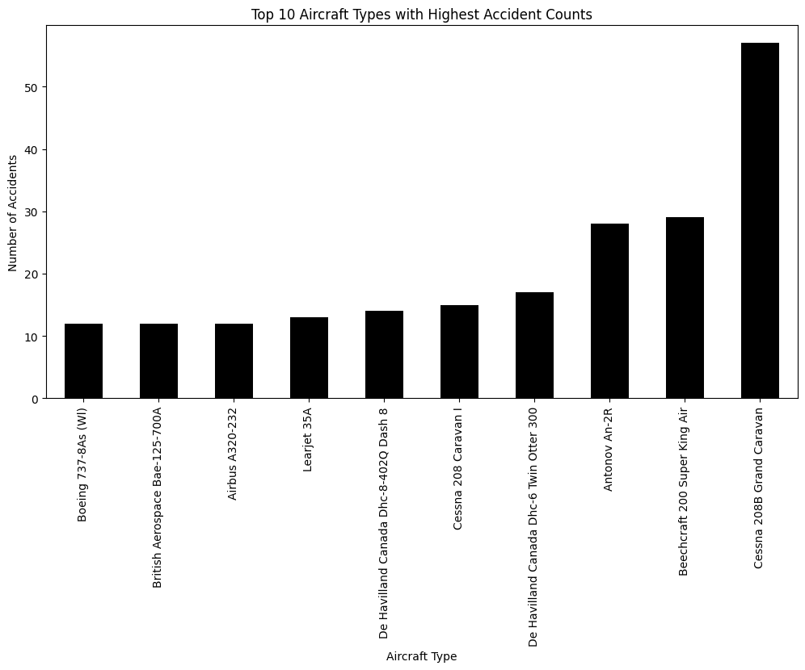
Aircraft with Most Accidents Top 10

Slide 7
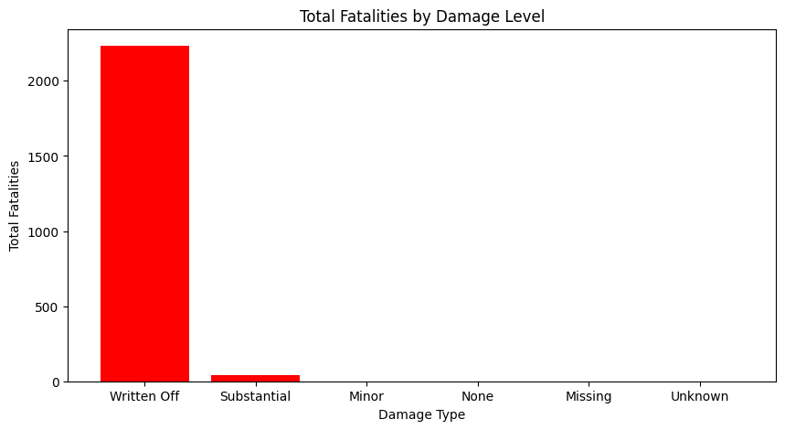
Fatalities and damage severity

Slide 8
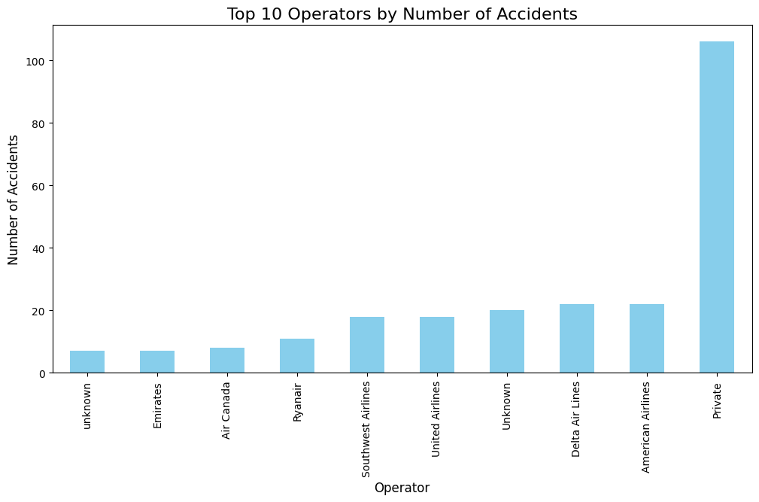
Accidents by Operator

Slide 9
Findings
1.The highest number of accidents were in 2019, followed by 2018.Accidents dropped significantly in 2020-2021,due to COVID-19 lockdowns, with a slight increase in 2022 as aviation operations resumed.
2.The Cessna 208B Grand Caravan experienced most accidents, followed by Beechcraft 200 Super King Air, Antonov An-2R, De Havilland Canada DHC-6 Twin Otter 300, and Cessna 208 Caravan I.
3.Aircraft classified as ‘written off’ show the highest fatality rates, while accidents with ‘substantial’ damage resulted in relatively few fatalities.
4.Private operators experienced the highest number of accidents, highlighting a potential area for strict safety oversight.

Slide 10
Recommendations
Avoid aircraft models associated with high fatality rates.
Prefer aircraft with low severity accident history.
Implement strict safety oversight for private operations.
Use historical data in all procurement decisions.

Slide 11
THE END
THANK YOU Q& A SECTION

